Slide 1
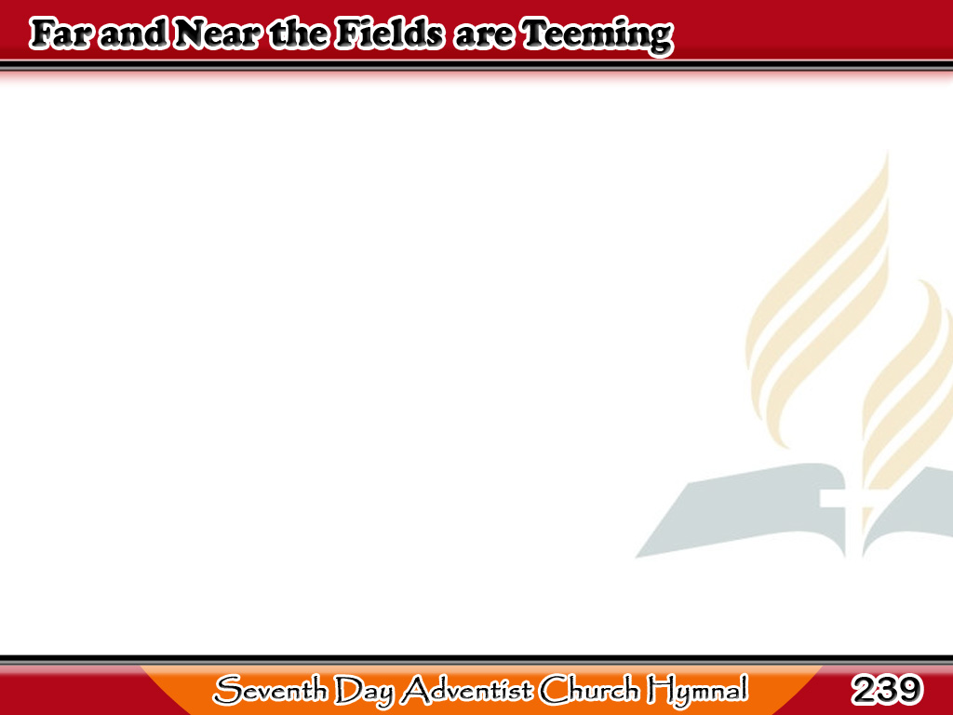
Hinog na ang mga Uhay
Far and near
the fields are teeming
With the sheaves
of ripened grain;
1/3

Slide 2
Hinog na ang mga Uhay
Far and near
their gold is gleaming
O’er the sunny slope
and pain.
1/3

Slide 3
Hinog na ang mga Uhay
-Refrain-
Lord of harvest,
send forth reapers!
Hear us, Lord,
to Thee we cry;
1/3

Slide 4
Hinog na ang mga Uhay
-Refrain-
Send them now
the sheaves to gather,
Ere the harvest
time pass by.
1/3

Slide 5
Hinog na ang mga Uhay
Send them forth
with morn’s first beaming,
Send them in
the noontide’s glare;
2/3

Slide 6
Hinog na ang mga Uhay
When the sun’s last rays
are streaming,
Bid them gather
everywhere.
2/3

Slide 7
Hinog na ang mga Uhay
-Refrain-
Lord of harvest,
send forth reapers!
Hear us, Lord,
to Thee we cry;
2/3

Slide 8
Hinog na ang mga Uhay
-Refrain-
Send them now
the sheaves to gather,
Ere the harvest
time pass by.
2/3

Slide 9
Hinog na ang mga Uhay
O thou, whom thy Lord
is sending,
Gather now
the sheaves of gold;
3/3

Slide 10
Hinog na ang mga Uhay
Heavenward then
at evening wending
Thou shalt come
with joy untold.
3/3

Slide 11
Hinog na ang mga Uhay
-Refrain-
Lord of harvest,
send forth reapers!
Hear us, Lord,
to Thee we cry;
3/3

Slide 12
Hinog na ang mga Uhay
-Refrain-
Send them now
the sheaves to gather,
Ere the harvest
time pass by.
3/3

